Slide 1


NMIT POLYTECHNIC-568 karunadu intership presentation-2023
PRESENTED BY:
NADIMICHARLA REDDY KUMAR ,
Diploma in CSE,
USN:568CS21025,
Course:Artifical Intelligence and Machine Learning.

Slide 2
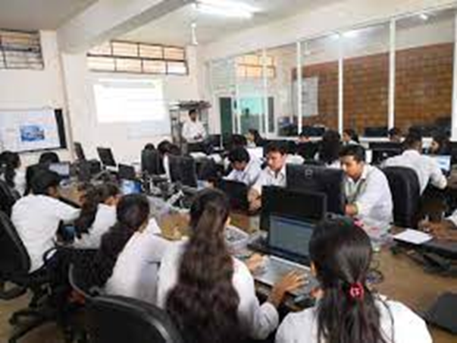
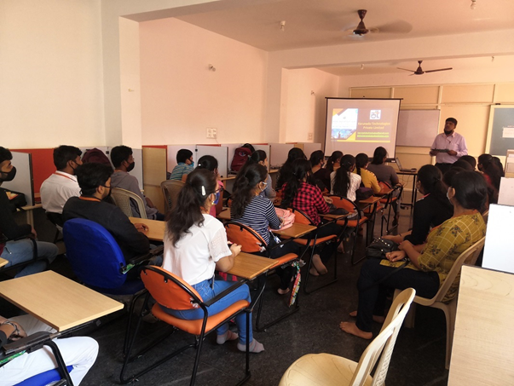
RESEARCH
INTERNSHIPS
PROJECTS
WORKSHOPS
INTERNSHIP CARRIED OUT AT KARUNADU TECHNOLOGIES PRIVATE LIMITED

Slide 3
Topics learnt during Internship
LOGISTIC REGRESSION
SVM(SUPPORT VECTOR MACHINE)
MULTIPLE LINEAR REGRESSION
KNN(K-NEAREST NEIGHBOUR)
RANDOM FOREST METHOD
INTRODUCTION TO AI & ML
BASICS IN PYTHON(STR,DICT,LIST,TUP,ETC
INSTALLATION OF ANACONDA PROMPT
USE OF JUPYTER NOTEBOOK
MANY MORE . . .

Slide 4
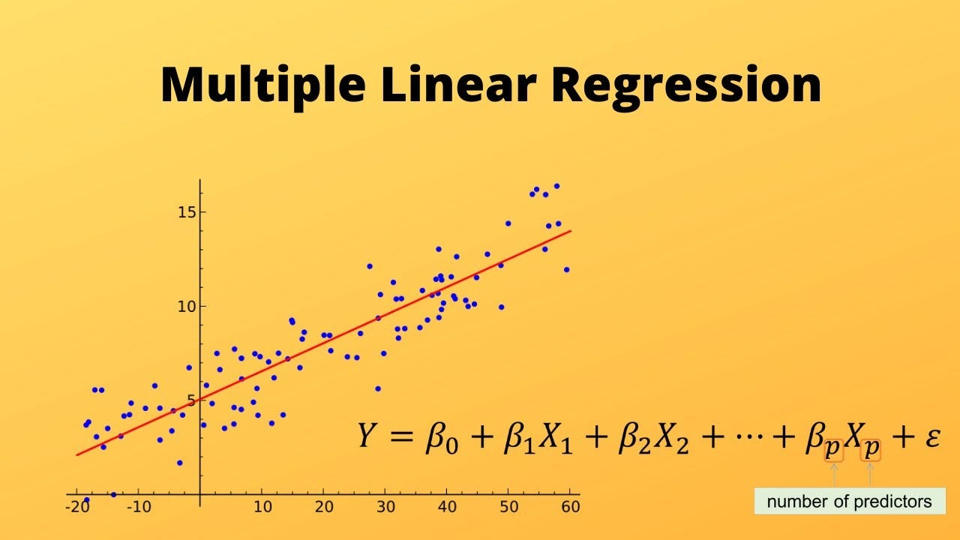
Crop Yield Coimbatore Prediction using Multiple Linear Regression. Multiple Linear Regression ALGORITHM.
Predicting crop yield using Multiple Linear Regression (MLR) involves using several independent variables to predict a dependent variable (in this case, crop yield). Coimbatore, a region in southern India, has a largely agrarian economy, and using historical data from this region could provide accurate yield predictions.

Slide 5
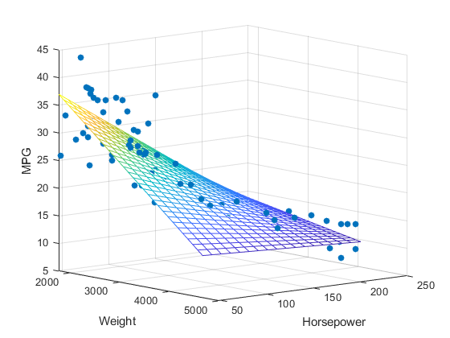
In the previous topic, we have learned about Simple Linear Regression, where a single Independent/Predictor(X) variable is used to model the response variable (Y). But there may be various cases in which the response variable is affected by more than one predictor variable; for such cases, the Multiple Linear Regression algorithm is used.

Slide 6
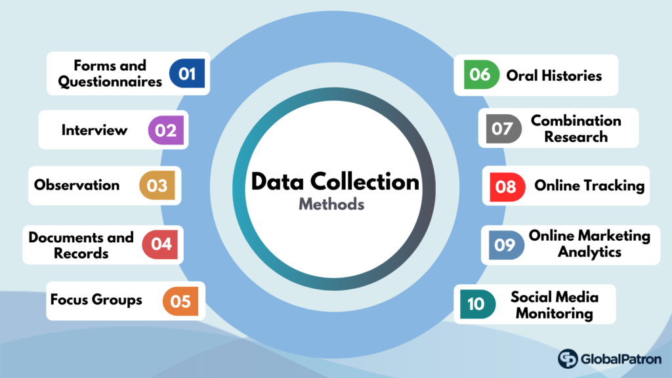
Data Collection
Gather data on crop yield in Coimbatore for several years.
Collect data on potential independent variables such as rainfall, temperature, fertilizer used, area of land, pest infestations, etc.

Slide 7
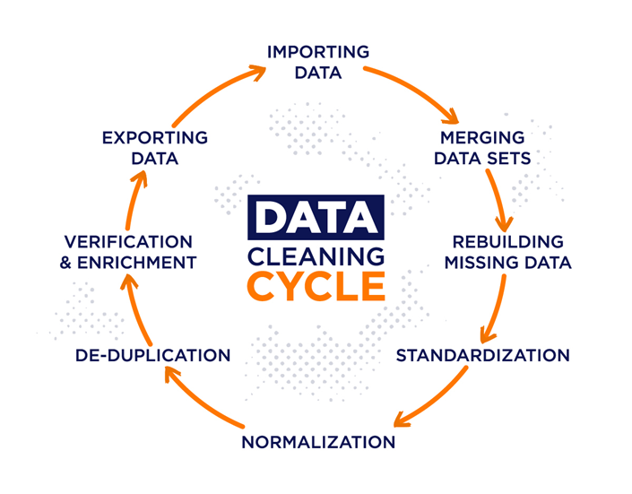
Data Cleaning
Handle missing values (imputation or deletion).
Outlier detection and treatment.
Check for multicollinearity amongst independent variables (VIF - Variance Inflation Factor can be used).

Slide 8
Data Splitting
We’re going to use a couple of libraries in this article: PANDAS to read the file that contains the dataset,SKLEARN.MODEL_SELECTION to split the training and testing dataset, and MATPLOTLIB to draw the regression line.
In this step, we’ll load our CSV file to explore the dataset by using pd as a pandas reference variable and call the READ_CSV function along with the file name to read the file.
Before splitting up the dataset into training and testing datasets, our focus must be finding the dependent and independent variables. Once these variables are prepared, then we’re ready to go to split up the dataset.
Now we’re going to fit our x and y into a machine-learning model to predict the output, but before that, we have to import the LOGISTIC REGRESSION from the SKLEARN.LINEAR_MODEL and create an object of the LINEARREGRESSION CLASS.

Slide 9
Model Building
Use a statistical tool or programming language like Python or R.
In Python, you can use the ‘Statsmodels’ or ‘scikitlearn’ libraries to create an MLR model.
Method of Building Models :
All-in
Backward-Elimination
Forward Selection
Bidirectional Elimination
Score Comparison

Slide 10
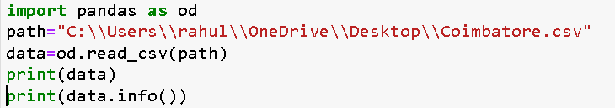
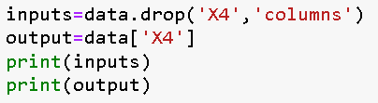
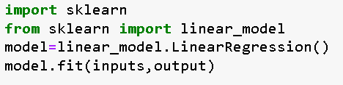
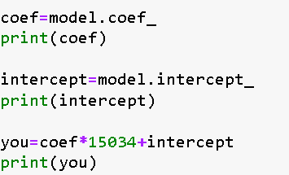
Programming steps
First, import pandas as pd.
Then, read the path and print the data and data.info.
Then, input output, inputs.
Then, import sklearn, from sklearn import linear_model.
Then, use the fillna method.
Then, input the coef, intercept, you.
Then, calculating the coef and printing it.
Then, calculating the intercept and printing it.
Then, calculating the you and printing it.

Slide 11
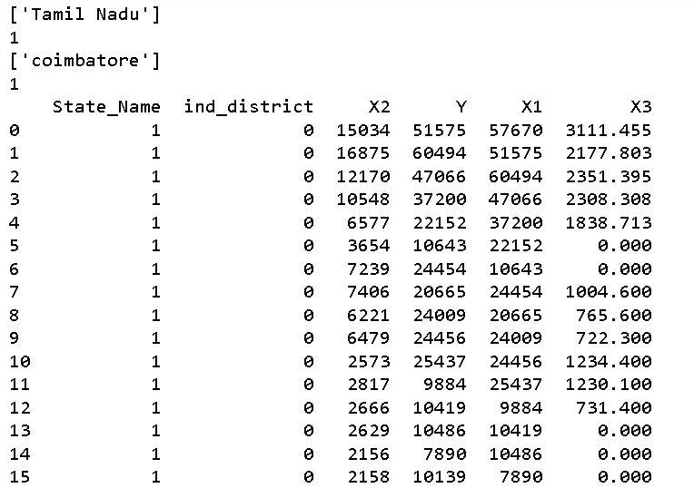
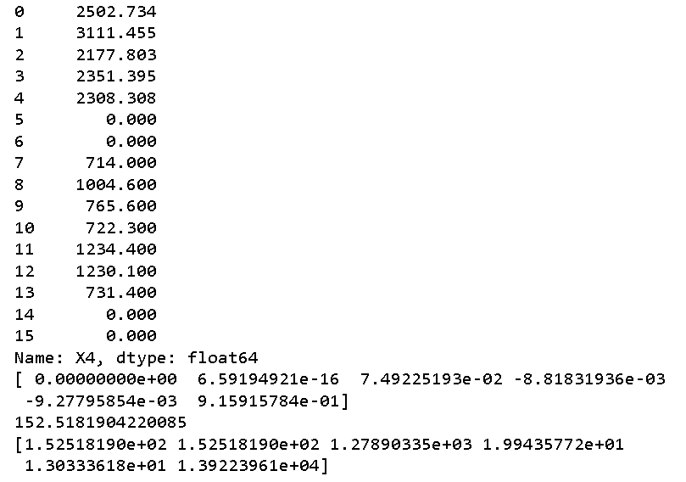
Results with snapshots

Slide 12


INTERNSHIP CARRIED OUT AT KARUNADU TECHNOLOGIES PRIVATE LIMITED
Student’s sem:5th sem
College Name: NMIT Polytechnic

